Slide 1
Movie Recommender System -Team Whatflix-
ByungHyun Lee
JunYeong Ahn
JiHong Jeong

Slide 2
Problem and Goal
Problem : Recently, types of movies and the taste of people for them
have become so various that even people themselves find it hard to select movies they want,
thereby movie-watching platforms cannot help but develop contents recommendation system.
Goal : To develop unique movie recommendation system based on similarity analysis, using what we’ve learned during this year

Slide 3
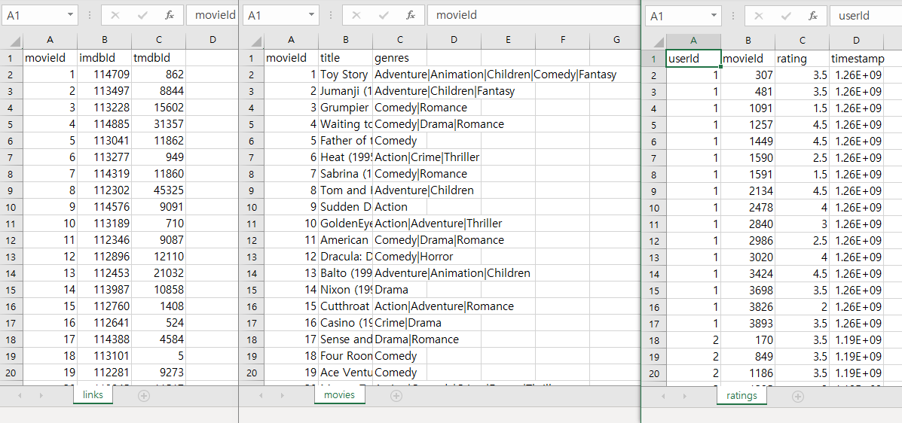
Glimpse on Data – links, movies, ratings.csv
user id : simple id
rating : rated by users
timestamp : passed time since 1970.01.01
movie Id : simple id
Imdb Id : id in imdb.com
tmdb Id : id in themoviedb.org
title : movie title
genres : movie genre

Slide 4
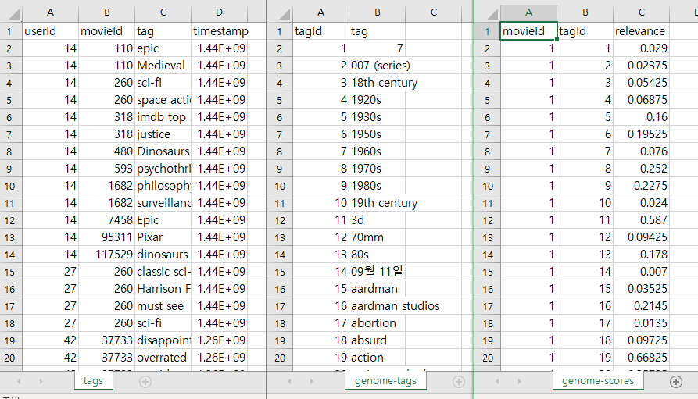
Glimpse on Data – tags, genome-tags, genome-scores.csv
tag: user-generated metadata
for each movie
tag id : simple id for tags
relevance : movie-tag relevance
Jesse Vig, Shilad Sen, and John Riedl. 2012. The Tag Genome: Encoding Community Knowledge to Support Novel Interaction. ACM Trans. Interact. Intell. Syst. 2, 3: 13:1 -13:44. https://doi.org/10.1145/2362394.2362395

Slide 5
chosen data set overall
‘Movielens - latest’ data consists of six different tables,11 columns and 43842293(43M) rows
in total (before merging)
Target variable : ‘rating’(ranges from 0.5~5) – prediction on rating as a regression problem
Major predictors : Not determined yet (they will be after tree-based feature selection),
but 1) ‘rating’ column is fundamental for similarity calculation between users (user-based).
and 2) ‘genre’ column is as well for similarity calculation between contents (contents-based).
+ some hidden cards?

Slide 6
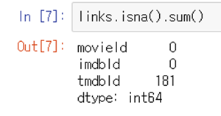
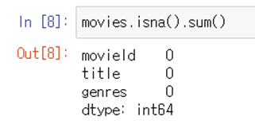
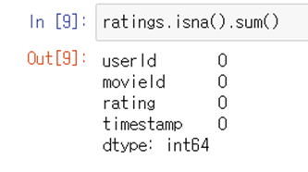
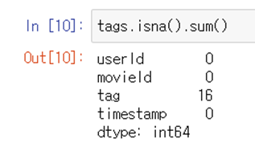
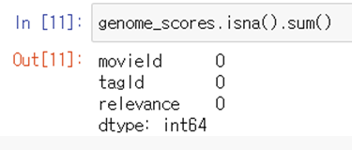
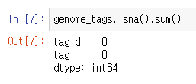
Chosen Data Set Overall
Data quality : not bad, but also not good…

Slide 7
Current Idea of Modeling Approach
Full Data
Data A for user information
Data B for movie information
User-based Collaborative Filtering(CF)
Movie-based Collaborative Filtering(CF)
Collaborative Filtering(CF) CF is a technology based on assumption users' past trends will remain
the same in the future, and is the most basic and
important core technology of the recommendation system.
Here, similarities between users and between movies are calculated to construct CFs.

Slide 8
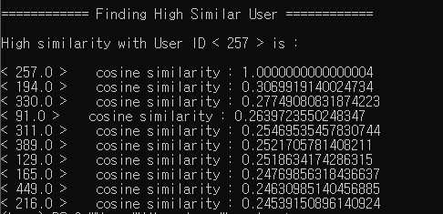
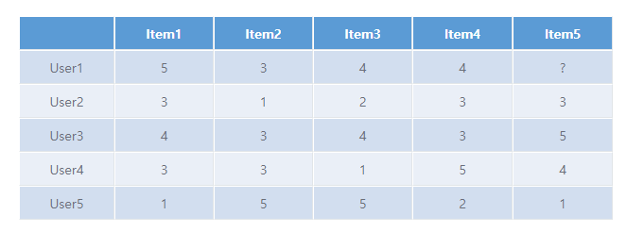
Similarity Calculations + Ongoing Works…
User-Based CF as one example of similarity calculations
-using cosine similarity

Slide 9
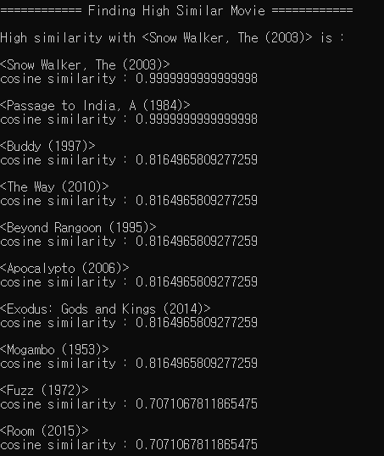
Ongoing Works…
Movie-Based CF as one example of similarity calculations
-using cosine similarity

Slide 10
Current Idea of Modeling Approach
Cold Start problem
Full data
Survey & Web crawling
Rating of the user
Data A for user
Data B for movie
Recommend ‘top 5’ movies
to the user
Data
User-based CF
Movie-based CF
Comparison
Feature creation
ML
H.P
H.P
Pre-processing
‘Rating’ regression using
XGBoost & Ada boost
Feature selection

Slide 11
Another Possible Modeling Approach
Matrix Factorization(MF) Unlike our approach, which uses similarity between users and items,
MF uses a mathematical method called matrix factor decomposition to
directly analyze user-movie correlations.
Alternating Least Squares(ALS)
A method to minimize the objective function of MF.
But we won’t use it, since it is close to black box.

Slide 12
WPs
WP1 | Understanding on given data and EDAs – ‘Movielens latest data’
1.1 – Getting a basic comprehension on Movielens data – how the data were collected and whether there is a special criterion on choosing subjects (Done)
1.2 – Full understanding on all the columns in dataset and conceiving how we can utilize them in unique way (Done – Regression problem targeting ‘rate’ column)
1.3 – Conduct some EDAs so that we can grasp the distribution of all the columns and correlation between them (Done)

Slide 13
WPs
WP2 | Data cleansing and pre-processing
2.1 – Merge the given six tables into two data – one is for analyzing user-user correlation, another for analyzing content-content correlation (for WP 3.1 & 3.2) (Ongoing)
2.2 – Based on overall apprehension on data from WP 1.3, imputation, normalization and some other pre-processing will be carried out here (Ongoing)
2.3 – Add a new column called ‘Top N rank movies for each day’ to the data from WP 2.2 through web crawling so that we can figure out whether ‘hot-movie trend’ influences on movie selection

Slide 14
WPs
WP3 | Feature selection & creation for performance improvement
3.1 – Calculation for ‘movie-movie similarity’, so-called Collaborative Filter(CF), using pearson correlation matrix (tentative, could be replaced by another matrix later) with data from WP 2.1
3.2 – Calculation for ‘movie-movie similarity’, using cosine similarity matrix with data from WP 2.1
3.3 – Based on two similarity-calculations above, create a new column such as ‘Ratings given to this Movie by top 5 similar users with this User’ and ‘Ratings given by this User to top 5 similar movies with this Movie’
3.4 – With the final data, conduct feature selection based on feature_importance of XGBoost, one of tree-based model

Slide 15
WPs
WP4 | Modeling with some tuning methods
4.1 - Hyperparameter tuning (on No. of trees, learning rate, ,,,) will be conducted against the XGBoost model after feature selection (WP 3.4) with 5-fold CV
4.2 – Try combining some other models with the best model so far from WP 4.1

Slide 16
WPs
WP5 | Analysis & evaluation for application in real-world
5.1 - All the results from previous steps are visualized into easily understandable format
5.2 - Evaluation on the final model through traditional ‘test/train’ based on evaluation metrices – RMSE, MAE and nDCG(normalizing Discounted Cumulative Gain)
5.3 – Prudent verification of whether the recommendation model will work well in real-world business, including comparison to pre-existing contents recommenders

Slide 17
GANTT Chart
Date | 30 | 1 | 2 | 3 | 4 | 5 | 6 | 7 | 8 | 9 | 10 | 11 | 12 | 13 | 14 | 15 | 16 | 17 | 18 | 19 | 20 | 21
WP1
WP2
WP3
WP4
WP5
Presentation
Weekly summary
Milestone |  |  |  |  |  | 1 |  |  |  | 2 |  |  |  |  |  |  | 3 |  |  |  |  | 4
WP1: Understanding on given data & EDAs
WP2: Pre-processing
WP3: Feature selection & creation
WP4: Modeling with some tuning
WP5: Analysis & evaluation
M1: CFs constructed
M2: data prepared
M3: model trained
M4: recommender completed

Slide 18
Remaining challenges
<Tag> column in ‘tags.csv’ file : The short comment (metadata) for each movie of the user,
but there is no fixed answer form for it (someone wrote ‘funny’, some did ‘MMA’, Leonardo, true story,,,).
Web crawling could make my IP blocked from the website unless they have certain API.
Creating many unique features may take a lot of time than our expectation.
XGBoost won’t let us easily interpret the results from it.

Slide 19
Expected Questions
Q1. Why did you select tree-based model, not a linear one?
A. It’s because tree-based model has much less assumptions for something
like residual distribution and limitations compared to linear model.
Also, tree-based model provides us with feature importance plot, which can help us to
upgrade the model later.

Slide 20
Expected Questions
Q2. Is it possible to use ‘rating’ as a target and a feature to predict it as well?
A. Actually ‘no’ if it directly used – however we conducted some variations.
Of course our target is ‘rating’, but actually it won’t be directly used as a feature.
It will be transformed into a new column, combined with Collaborative Filters; top secret.

Slide 21
Thank you for your attention :)

